Slide 1
Digital Image Processing
Associate Prof. Zhang Qingfeng(张庆丰)
Department of Computer Science, Jinan University
Office Room: 415, Nanhailou Building
Email: zqf135@qq.com
1

Slide 2
Chapter 3
Intensity Transformations and Spatial Filtering (2)
2

Slide 3
Contents
Background
Some Basic Intensity Transformations Functions
Histogram Processing
Fundamentals of Spatial Filtering
Smoothing Spatial Filtering
Sharpening Spatial Filters
Combining Spatial Enhancement Methods
Summary
3

Slide 4
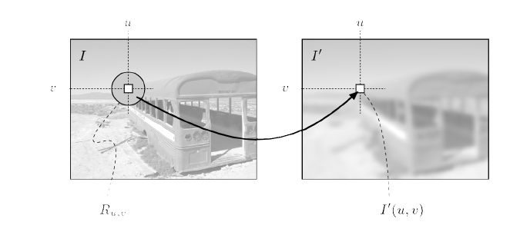
Fundamentals of Spatial Filtering
Spatial filter (also called spatial mask, kernel, template or window) is an image operation where each pixel value I(u, v) is changed by a function of the intensities of pixels in a neighborhood of (u, v).

Slide 5
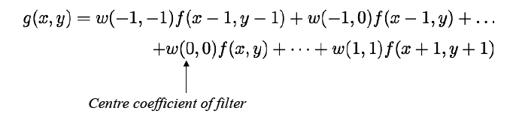
The Mechanics of Spatial Filtering
Filtering creates a new pixel with coordinates equal to the coordinates of the center of the neighborhood, with value = result of the filtering operation.
Example : linear spatial filter using a 3×3 neighborhood
At any point (x,y) in the original image, the response, g(x,y), of the filter:

Slide 6
The Mechanics of Spatial Filtering
Image size:
Mask size:
and
and

Slide 7
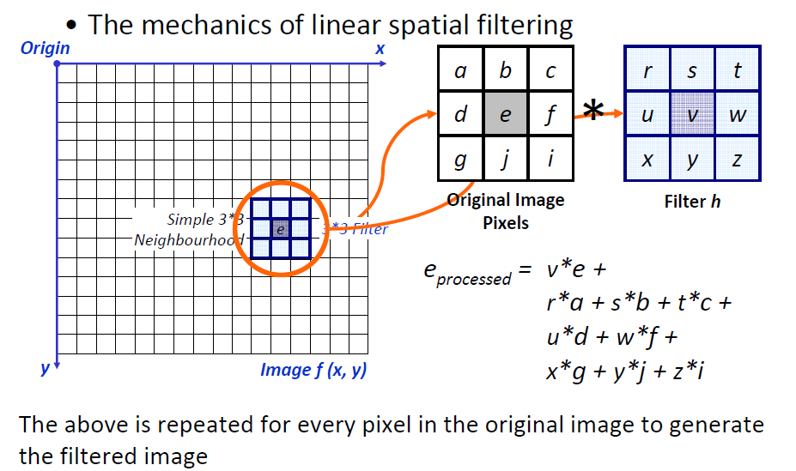

Slide 8
Spatial Correlation and Convolution 相关性和卷积
Correlation is a process of moving the filter mask over the image and computing the sum of products at each location as previously described.
Convolution is the same except that the filter is first rotated by 180°
For a 1D case, we first zeropad f by m-1 zeros on each size. We compute a sum of products in both cases…

Slide 10
Correlation is a function of displacement of the filter
If f contains all 0s and only one 1 (discrete unit impulse) => copy of w rotated by 180°
i.e. correlation of a function with a discrete unit impulse => rotated version of the function at the location of the impulse
Convolving a function with a unit impulse => copy of w at the location of the impulse
Convolution: rotate one function by 180° and perform same operations as in correlation

Slide 11
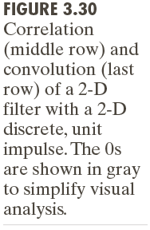

Slide 12
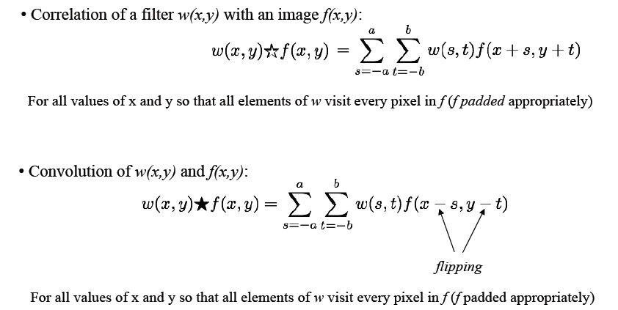
Spatial Correlation and Convolution

Slide 13
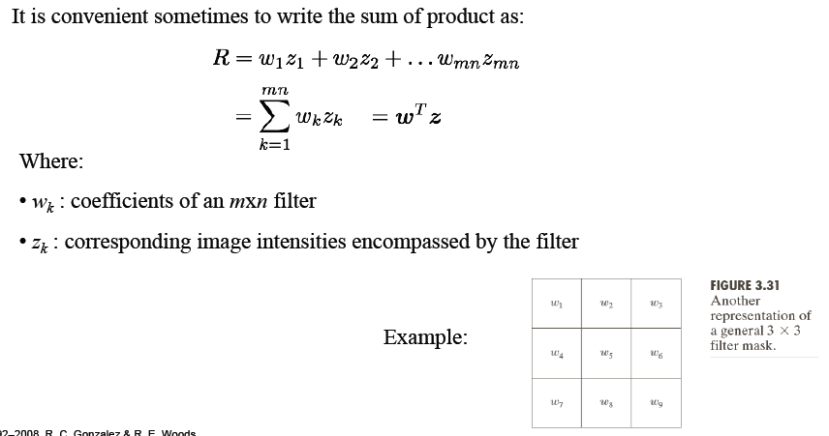
Vector Representation of Linear Filtering

Slide 14
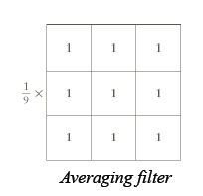

Generating Spatial Filter Masks
To generate a m×n linear filter, need to specify mn mask coefficients, selected based on what the filter is supposed to do
Example 1 :
average filter with 3×3 neighbourhood

Slide 15

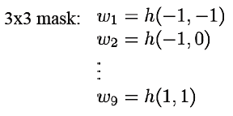
Generating Spatial Filter Masks
Example 2 :
spatial filter mask based on a continuous function of two variables
e.g. Gaussian Function:

Slide 16
Smoothing Spatial Filters
Smoothing filters are used for blurring and noise reduction. Blurring may be implemented in preprocessing tasks to remove small details from an image prior to large object extraction.
The output of a smoothing (averaging or lowpass) linear spatial filter is the average of the pixels contained in the neighborhood of the filter mask.
By replacing the value of every pixel in an image by the average of the intensity levels in the neighborhood defined by a filter mask, the resulting image will have reduced “sharp” transitions in intensities. Since random noise typically corresponds to such transitions, we can achieve denoising.

Slide 17
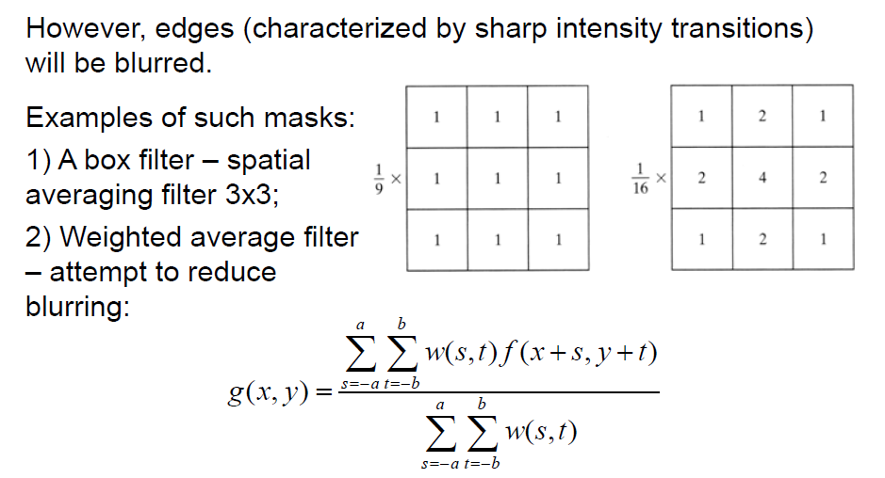
Smoothing Spatial Filters

Slide 18
The results of smoothing with a square averaging filter of sizes m = 3, 5, 9, 15, 25, and 35 pixels
Linear: Negative, Identity
Logarithmic: Log, Inverse Log
Power-Law: nth power, nth root

Slide 19
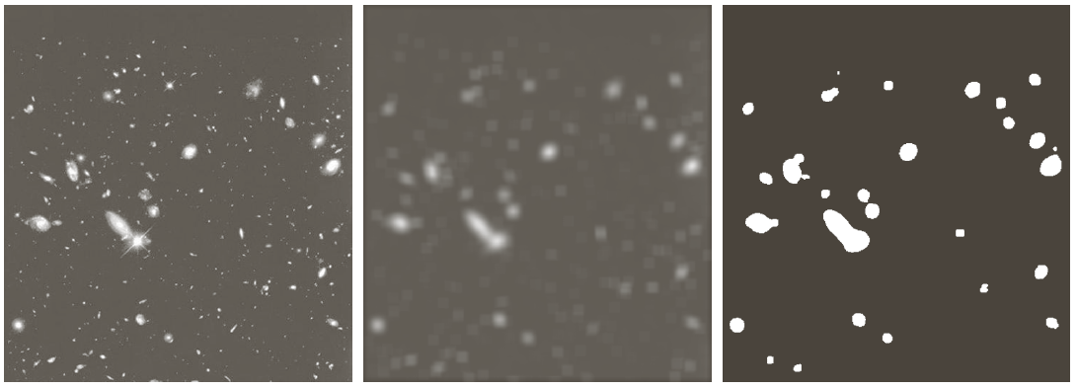
Frequently, blurring is desired for ease of object detection: an original Hubble image, the result of applying a 15x15 averaging mask to it and the result of thresholding with a threshold of 25% of the highest intensity.

Slide 20
Order-statistic (nonlinear) filters
Order-statistic filter are nonlinear spatial filters whose response is based on ordering (Ranking) the pixels in the neighborhood and then replacing the value of the center pixel by the value determined by the ranking result.
The median filters are quite effective against the impulse noise (salt-and-pepper noise). The median of a set of values is such that half the values in the set are greater than the median and half is lesser than it:
Notes:
['nɒn'lɪnɪəl]

Slide 21
For a 3×3 neighborhood, the median is the 5th largest value.
Neighborhood has the values
(10,20,20,20,15,20,20,25,100)
Sorted result
(10,15,20,20,20,20,20,25,100)
The median is 20.
There are also max and min filters.

Slide 22
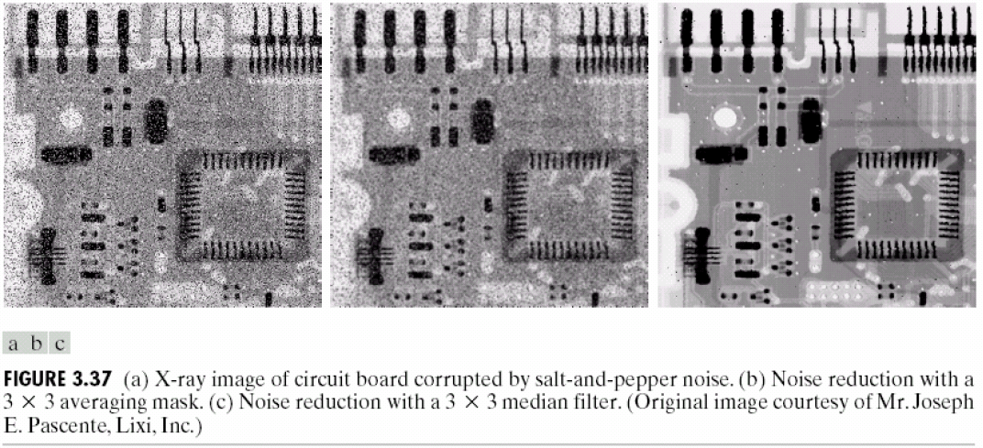
Example

Slide 23
Sharpening Spatial Filters
They are used to highlight transitions in intensity
Remove blurring from images
Highlight edges
Usually, such filters are based on discrete differentiation

Slide 24
Sharpening Spatial Filters
Foundation
The first-order derivative
The second-order derivative

Slide 25
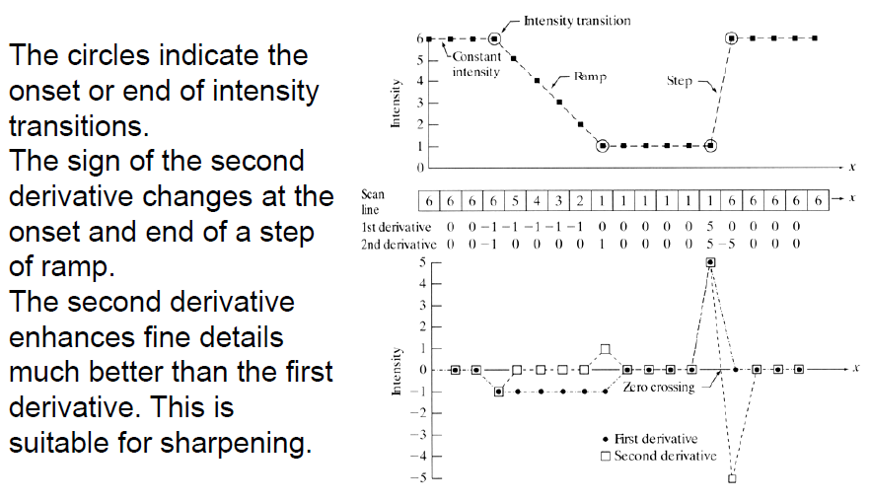

Slide 26
Using the second derivative for image sharpening-The Laplacian
Laplacian operator
It is based on 2nd-order partial derivatives
It can be used for highlighting intensity discontinuities in an image
The Laplacian is defined as follows:

Slide 27
Using the second derivative for image sharpening-The Laplacian
Its discrete forms are
In x-direction
In y-direction
=>

Slide 28
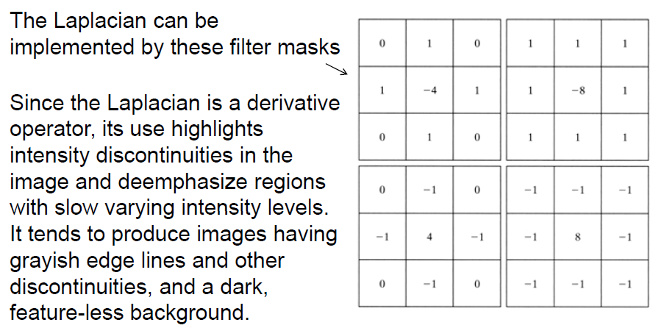
(a)
(b)
(c)
(d)

Slide 29
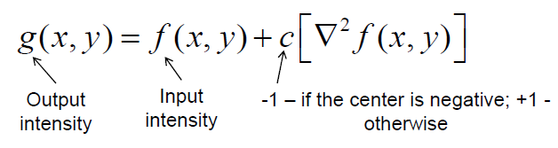
Background features can be preserved together with the sharpening effect of the Laplacian by adding the Laplacian image to the original.
If the definition of the Laplacian has a negative central coefficient, the Laplacian image must be subtracted rather than added to obtain a sharpening result. In general:

Slide 30
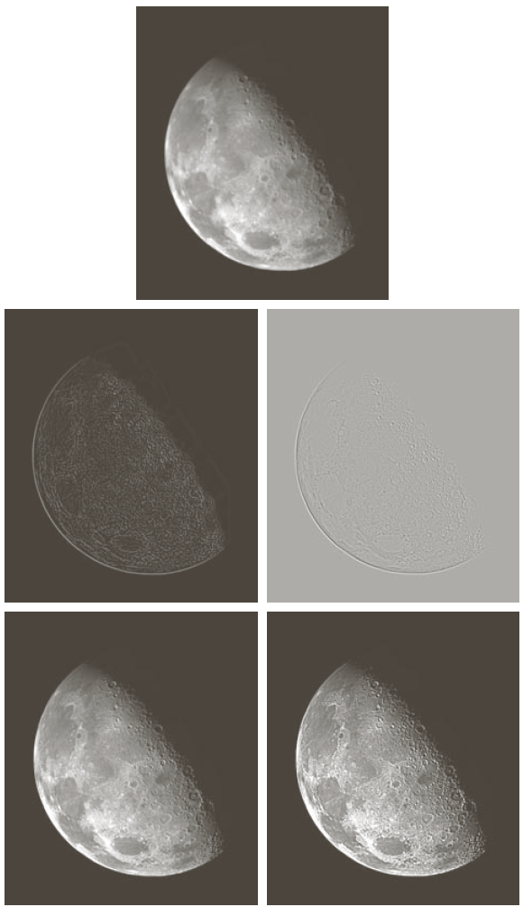

Slide 31
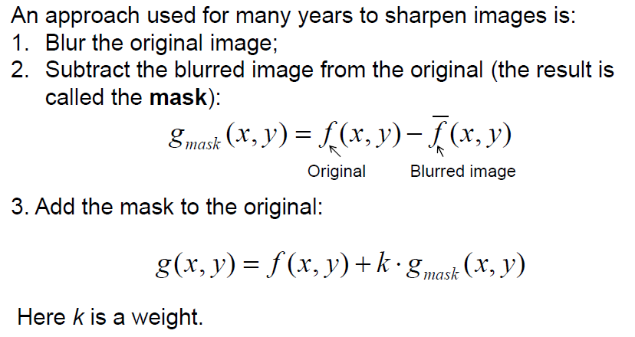
Unsharp masking and highboost filtering
31

Slide 32
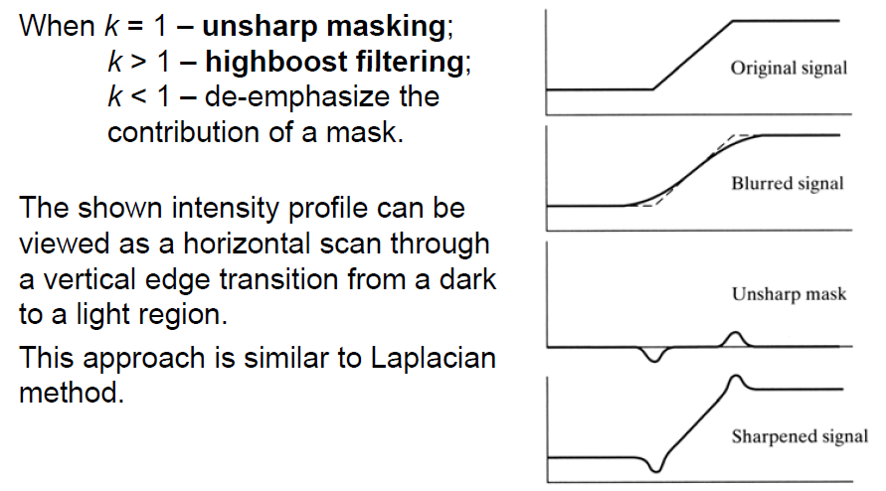
Unsharp masking and highboost filtering
32

Slide 33
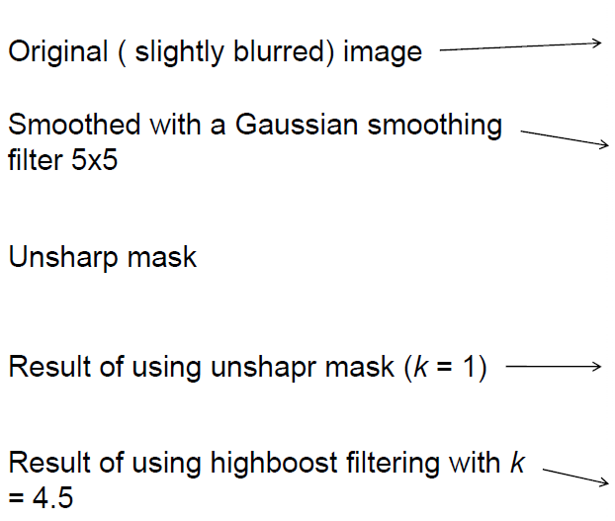
33

Slide 34
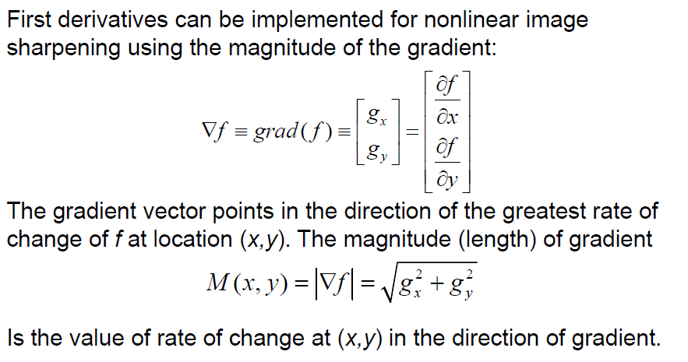
Gradient Method
34

Slide 35
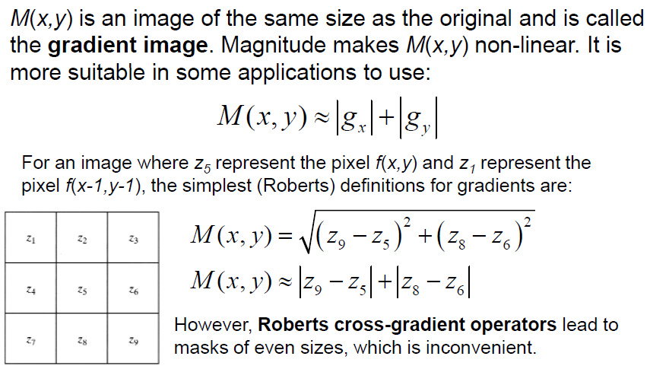
Gradient Method
35

Slide 36
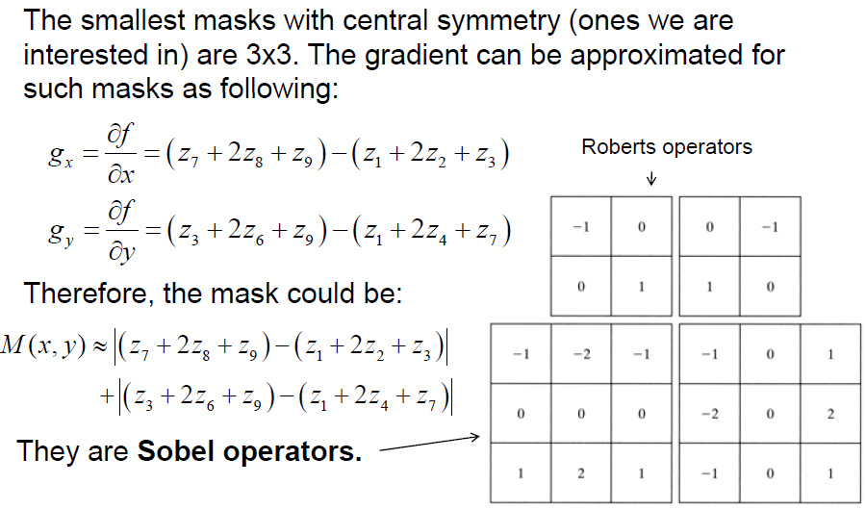
Gradient Method

Slide 37
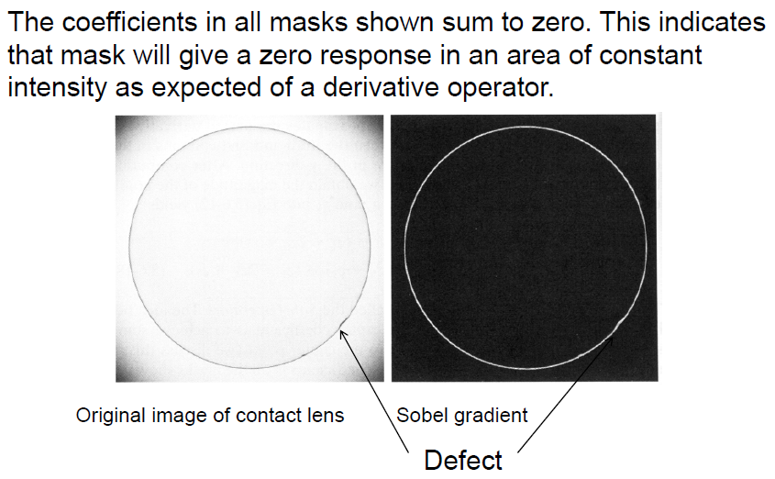
Gradient Method
37

Slide 38
Combining spatial enhancement techniques
Frequently, a combination of several methods is used to enhance an image…
1) Original image 2) Laplacian
3) image sharpened by Laplacian
4) Sobel gradient of the original image
5) Sobel image smoothed with a 5x5 averaging filter
6) product of Sobel image with its smoothed version
7) sharpened image (a sum of the original and 6)
8) power-law transformation.

Slide 39
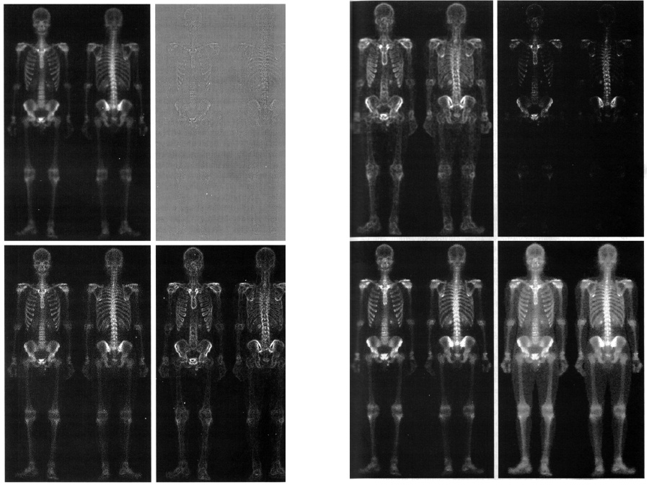

Slide 40
Summary
In this lecture, we have learned
About image enhancement
Some basic intensity transformation functions
Histogram processing
Fundamentals of spatial filtering
Smoothing spatial filters
Sharpening spatial filters
Combining spatial enhancement methods
40

Slide 41
Homework
pp.216 problem: 3.14, 3.21, 3.25
Extra problem
The right graph shows An image of 4x4
pixels. The number in every cell represents
the gray level on the corresponding pixel.
Please use robert operaters and soble
operaters to computer the gradient in
pixel (3,3).
.
7 | 12 | 20 | 45
2 | 20 | 15 | 12
30 | 23 | 7 | 33
50 | 10 | 35 | 10
Prixel (3,3)
41

